Slide 1

CMR Technical Campus Department of Information Technology
Major Project Stage-II
Review-I
Project Title: Automated Animal Species Identification via Deep Learning on Bio-acoustic Recordings
Project Supervisor:​
Name:​G.Shankar
Designation: Assistant Professor
Presented By:​
Batch No: 1
1.H. No: 227R1A1213 Name:D.HIMAVANI
2.H. No: 227R1A1203 Name:A.ANIKETH
3.H. No: 227R1A1235 Name:M.VISHWANI
4 H. No:217R1A12B4 Name:P.SOMNATH
​

Slide 2
CONTENTS
INTRODUCTION & OVERVIEW
EXISTING SYSTEM
DISADVANTAGES
PROPOSED SYSTEM
ADVANTAGES
SOFTWARE&HARDWARE REQUIREMENTS
NOVELTY OF THE PROJECT
ARCHITECTURE
MODULES
UML DIAGRAMS

Slide 3
INTRODUCTION &OVERVIEW
Bioacoustics is the scientific study of animal vocalizations and natural soundscapes, providing valuable insights into animal behavior, communication, and ecosystem health. It has become an essential tool for biodiversity monitoring and wildlife conservation.
Animal sounds carry species-specific information related to their behavior and characteristics.
Bioacoustics applications include classifying animal sounds to identify species and behavioral contexts.
Bioacoustics integrates animal vocalizations with behavioral and emotional responses of receivers.
Bioacoustics studies the biological mechanisms involved in sound production
It highlights differences between automated bio-acoustic classification and traditional acoustic classification methods.

Slide 4
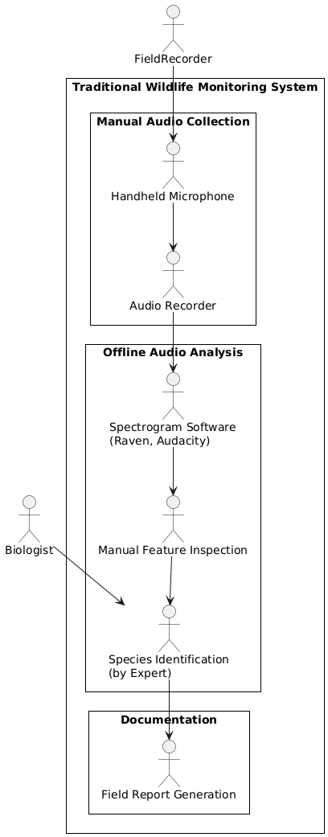
EXISTING SYSTEM
Traditional wildlife monitoring relied mainly on manual observation methods for animal species identification.
Visual sightings were commonly used by field biologists and ecologists to monitor wildlife.
Trap cameras were employed to capture animal presence and behavior.
Handheld microphones and passive recording tools were used to collect animal sounds.
Software tools such as Raven Pro and Praat were used for sound visualization and pattern matching.
Spectrogram inspection was used to study frequency and temporal characteristics of sounds.

Slide 5
EXISTING SYSTEM DISADVANTAGES
Manual analysis of audio recordings is extremely time-consuming and labor–intensive making it difficult to handle large datasets efficiently.
Accurate species identification requires specialized expert knowledge, which limits accessibility and scalability for broader ecological studies.
Human error is common, particularly in noisy environments or when multiple species’ calls overlap, reducing reliability.
Continuous monitoring is challenging as traditional methods cannot process real-time or high-frequency audio streams effectively.

Slide 6
PROPOSED SYSTEM
Audio Data Collection
Audio recordings are collected from a bioacoustics dataset containing species-specific sound signals. These recordings serve as the primary input to the system.
Data Preprocessing and Augmentation
Noise reduction and augmentation techniques are applied to improve audio quality and increase data diversity. This helps the model perform better in real-world conditions.
Train–Test Data Split
The processed dataset is divided into training and testing sets in an 80:20 ratio. This ensures reliable model training and unbiased performance evaluation.
Feature Extraction
Acoustic features such as MFCC, Chroma, and Spectral Contrast are extracted from the audio signals. These features capture essential frequency and perceptual characteristics.
Spectrogram Generation
Mel-spectrogram and STFT representations are generated to analyze time–frequency patterns. These representations highlight temporal and spectral variations in audio signals.

Slide 7
Deep Feature Extraction
Deep learning models extract high-level features from spectrograms automatically. These learned features capture complex sound patterns beyond manual feature design.
Hybrid Feature Representation
Handcrafted and deep features are combined to form a comprehensive feature set. This improves class discrimination and overall classification accuracy.
Model Training and Ensemble Learning
Machine learning and hybrid ensemble models are trained using the extracted features. Ensemble learning enhances robustness and reduces classification errors.
Model Evaluation
The trained models are evaluated using accuracy, F1-score, AUC, and confusion matrix. These metrics measure the effectiveness of the classification system

Slide 8
PROPOSED SYSTEM (ADVANTAGES)
Time-Saving: Automated feature extraction and classification reduce manual effort.
High Accuracy: Hybrid SVC + LGBM model improves prediction accuracy and reliability.
Real-Time Feedback: Audio playback and wave plot visualization give instant results.
Scalable System: Easily handles large datasets for continuous monitoring.
Adaptable Design: Can be applied to various animal species and environments.

Slide 9
SOFTWARE & HARDWARE REQUIREMENTS
SOFTWARE REQUIREMENTS:
HARDWARE REQUIREMENTS:
Python 3.7.6
Operating system: Windows
Development Tools:VS Code
GUI: Tkinter
Database: TinyDB
Processor: Intel i5
Memory: 1 TB (storage)
RAM: 8 GB

Slide 10
NOVELTY OF THE PROJECT
Proposes an automated deep learning–based system for animal species identification using bio-acoustic recordings.
Eliminates manual feature extraction by learning discriminative features directly from audio/spectrogram data.
Improves identification accuracy under real-world noisy environmental conditions.
Supports multi-species classification across different habitats using a single unified model.

Slide 11
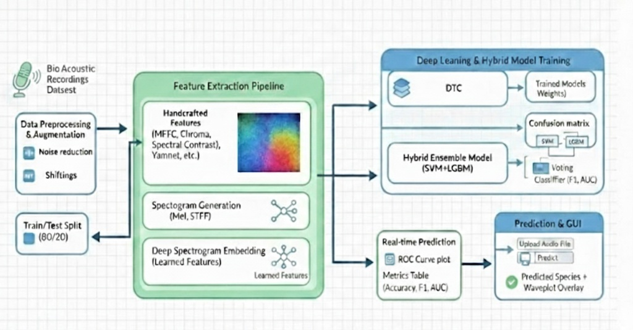
ARCHITECTURE

Slide 12
MODULES
Dataset Acquisition & Preprocessing
Collects bioacoustic audio files (.wav) for different animal species.
Converts stereo audio to mono for uniform input.
2. Audio Feature Extraction
Extracts important sound features such as MFCCs, Chroma, Spectral Contrast.
Converts raw sounds into numerical data that the model can understand.
3.Model Training & Evaluation
Trains multiple machine learning models (SVC, Decision Tree, and hybrid SVC–LGBM).
Uses extracted features to teach the system how to recognize species.
Tests the models using accuracy, precision, recall, and F-score.

Slide 13
4. Species Prediction & Visualization
Allows users to upload a new test audio file for prediction.
The trained hybrid model identifies the animal species automatically.
Plays back the sound for verification and shows the waveform graph.
Displays the predicted species name clearly on the interface.
5. Graphical User Interface (GUI)
Built using Tkinter for easy interaction.
Lets users upload data, extract features, train models, and predict species.
Provides real-time visualization and audio playback.
Makes the system user-friendly for researchers and wildlife experts.

Slide 14
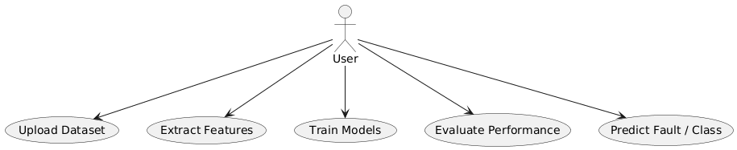
UML DIAGRAMS
USE CASE DIAGRAM

Slide 15
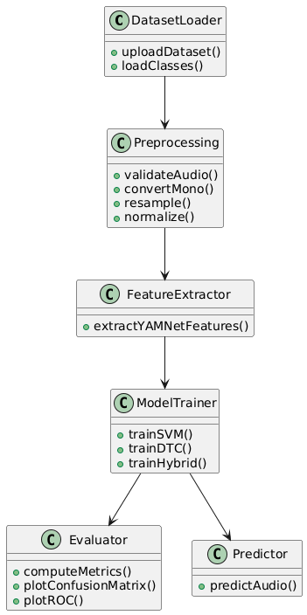
CLASS DIAGRAM

Slide 16
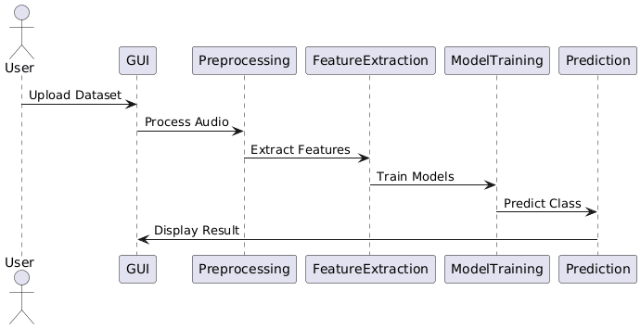
SEQUENCE DIAGRAM

Slide 17
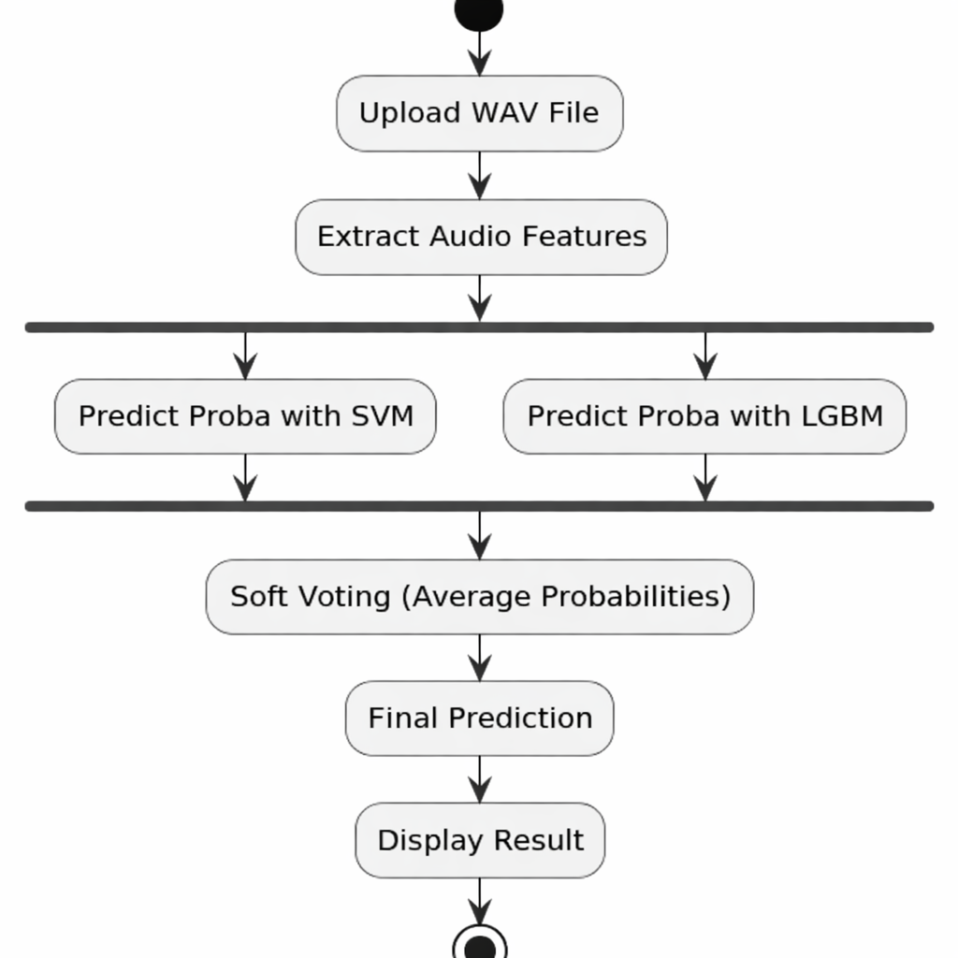
ACTIVITY DIAGRAM

Slide 18


